Slide 1
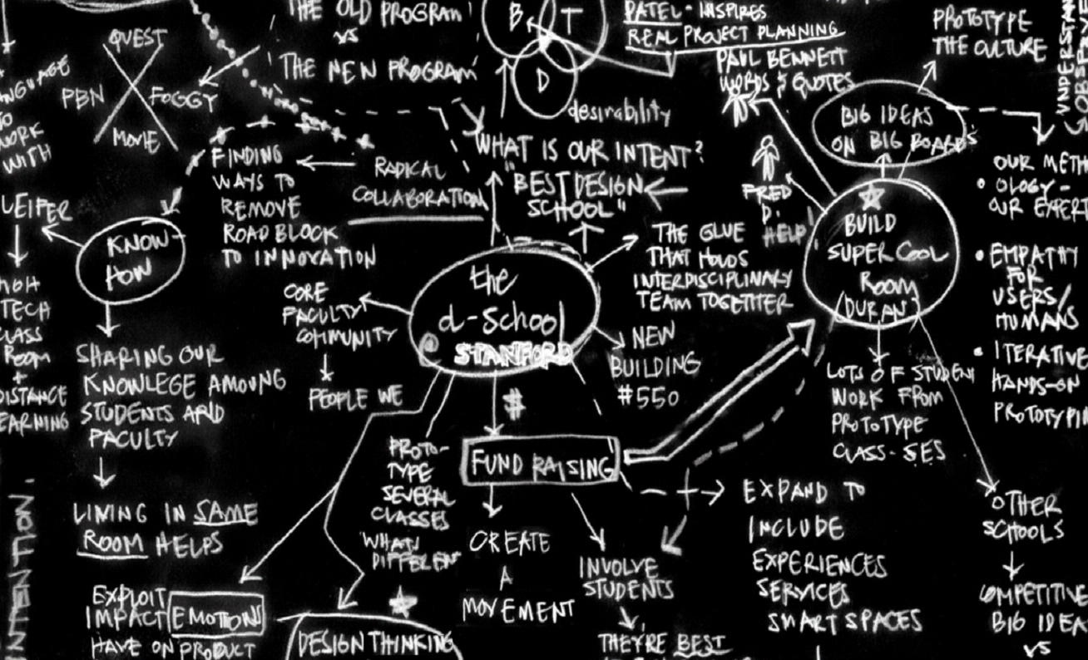
Co

Slide 4
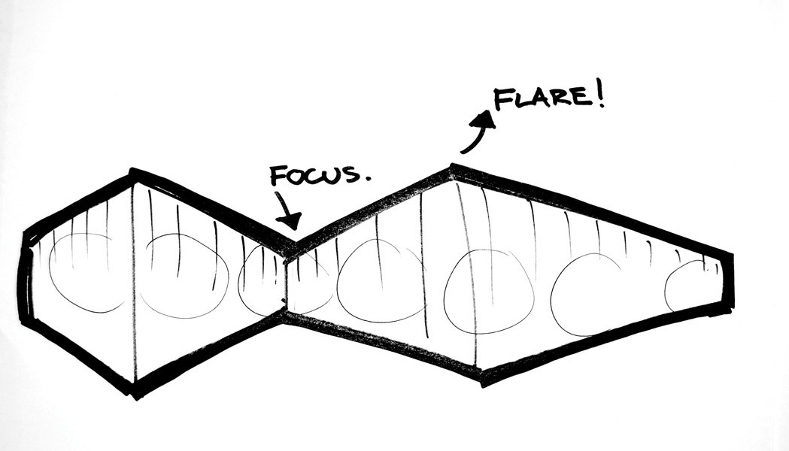
brainstorming
Notes:
Brainstorming is a very important flaring step! The more flaring that is done here the greater the options for a truly innovative outcome

Slide 5
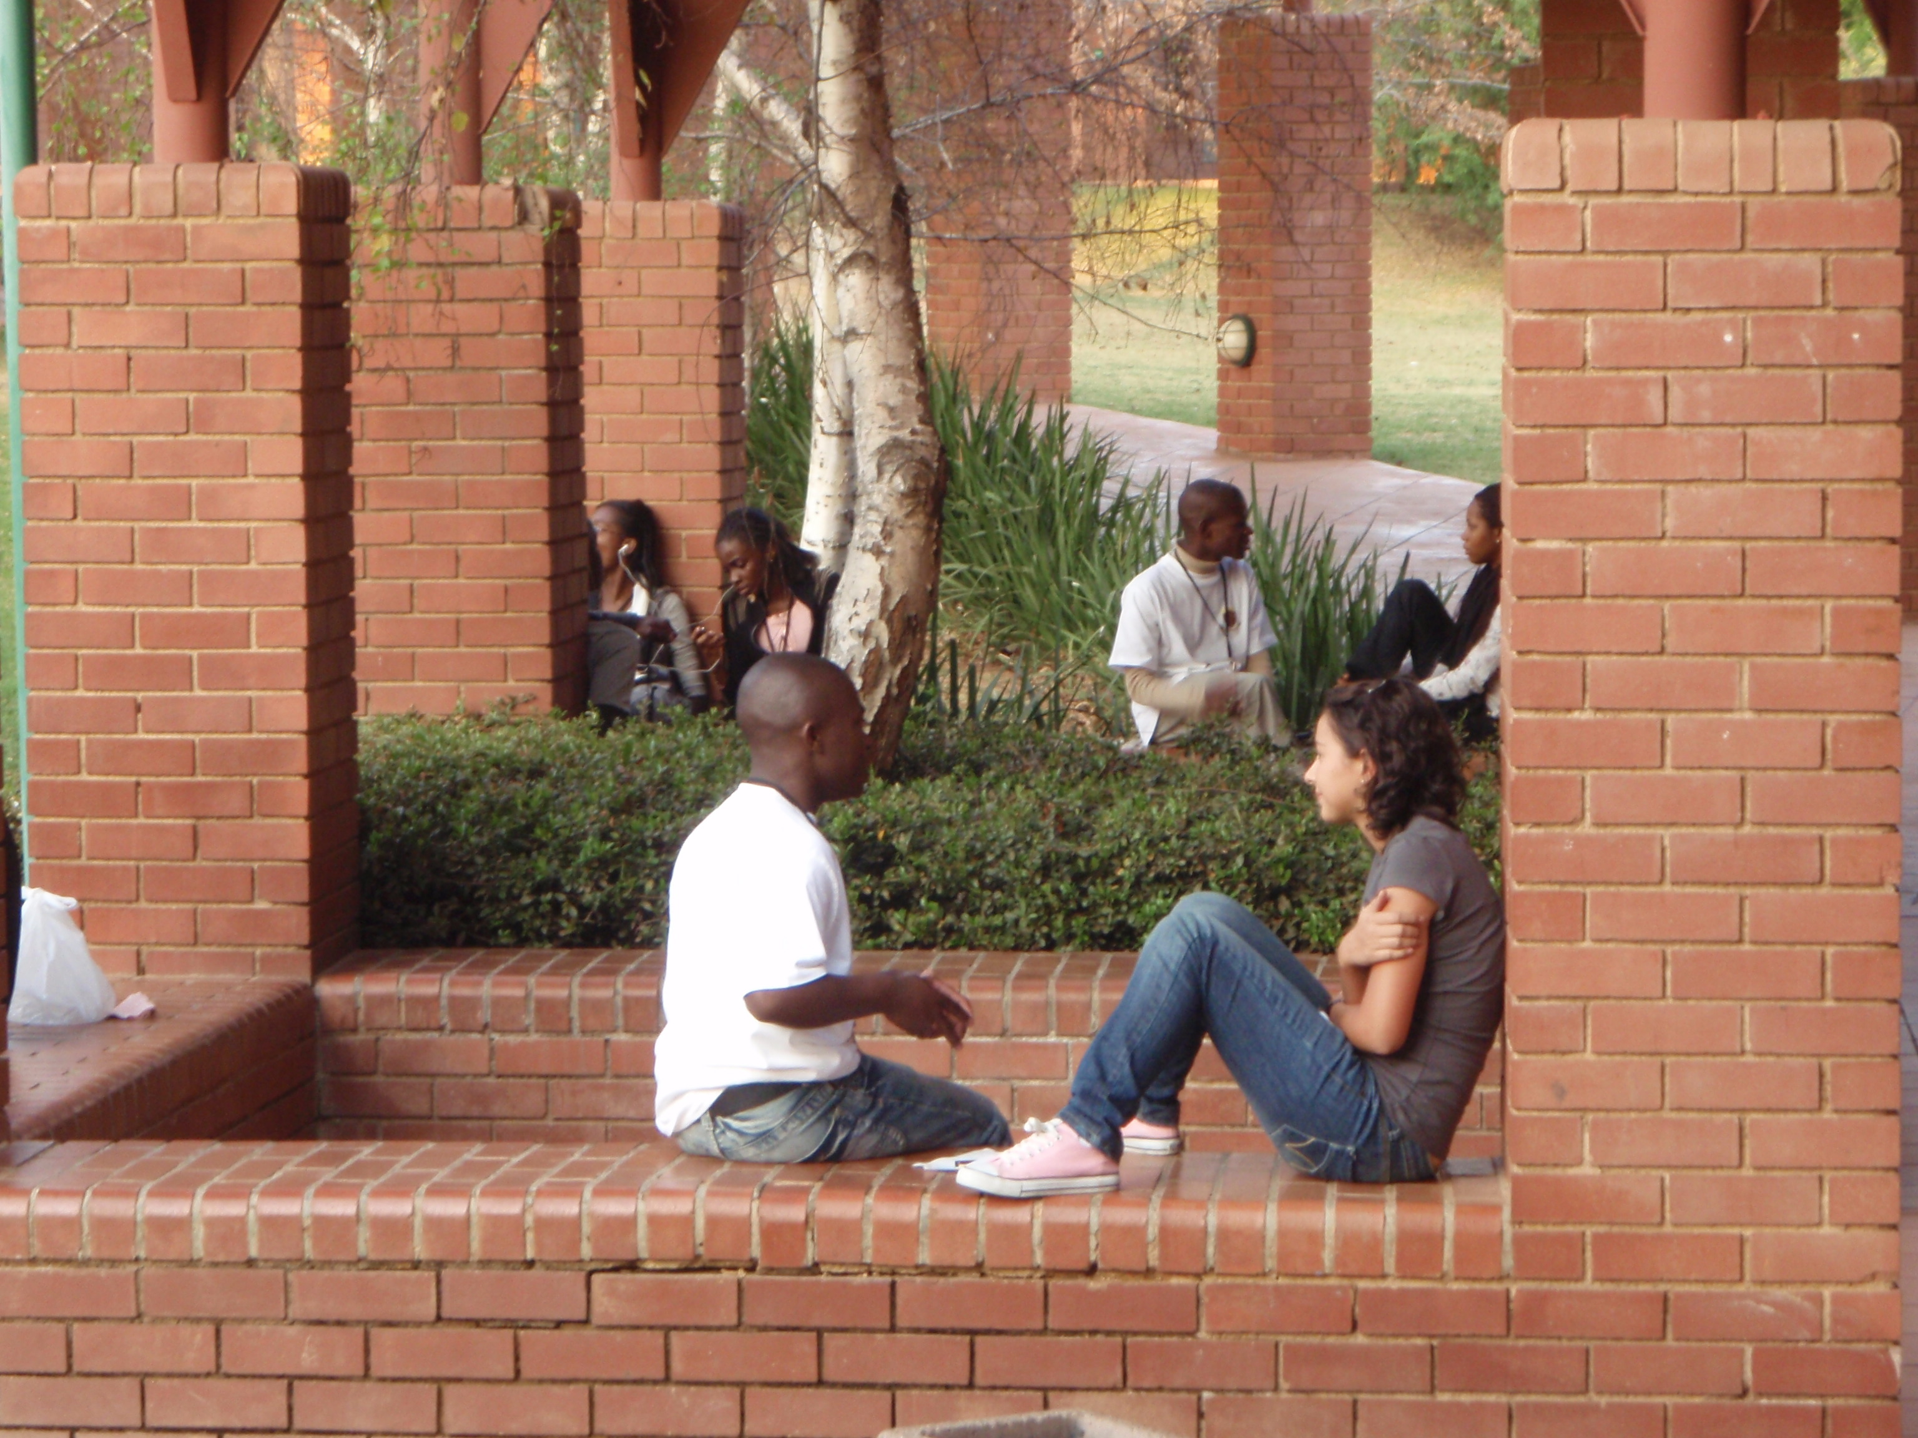
Brainstorming in Action
Notes:
Brainstorming is a very important flaring step! The more flaring that is done here the greater the options for a truly innovative outcome

Slide 6
WHY brainstorm
generate maximum innovation potential
in a short amount of time
incorporate different perspectives
and build EXCITEMENT, GAIN ALIGNMENT, and TRANSFER IDEAS

Slide 7
HOW to brainstorm: RULES
Notes:
If students are new to brainstorming it can be good to go over each of these rules in depth. As students become more experienced sometimes we just highlight the few that seem the most relevant to the group. (ie. Be visual, Defer Judgement, Go for wild ideas).
Fun video to illustrate ideas http://www.vimeo.com/11508426

Slide 8
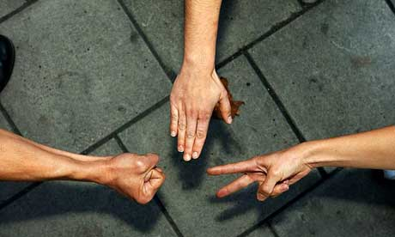
STOKE activity
05 MIN: Stoke activity
30 MIN: Setup, load, and run your brainstorming session(s)
Notes:
A stoke activity is something that raises the energy of the group. In this case we are using “Rock, Paper, Scissors Wars” to get the energy of the group high before they go into the brainstorming session.
Through out the brainstorming session be sure to walk around to the different groups to make sure that their energy is high. If energy starts to flag in one group think about giving a prompt such as “now come up with ideas that will cost over 1 million dollars.” Once it seems that energy around a specific idea is running out it may be time to move on to a new “How Might We”

Slide 10
idea SELECTION is a critical step
All the creative, wild, bad, OK, and undeveloped ideas from your brainstorm
When evaluated with typical “attractive” and “feasible” criteria before direct implementation
Yield familiar and incremental results

Slide 11
we will SELECT and DEVELOP high potential ideas
All the creative, wild, bad, OK, and undeveloped ideas from your brainstorm
Selected for potential
Can be developed for feasibility

Slide 12
for today VOTE using these 3 selection criteria
“Most likely to succeed”
Place two votes on the ideas that you think are most likely to successfully address your “how might we”
“Most likely to delight”
Place two votes on the ideas that you think would delight customers (without regard for practical constraints)
“Most breakthrough if …”
Place two votes on the most breakthrough ideas (if a fatal flaw or real world constraint were to be ignored)

