Slide 1
Empathy
Notes:
Service learning: to learn while serving others
can be direct, indirect or advocacy

Slide 2
What’s this?

Slide 3
ISP Mission Statement

Slide 4
Strong Words of the ISP Mission
1. ISP Inspires learners to lead healthy, fulfilling and purposeful lives, preparing them to adapt and contribute responsibly to our changing world.
2. ISP Engages its diverse community in an authentic global education, within a nurturing student-centered environment.
3. ISP Empowers students to
Think Critically and Creatively
Work Cooperatively and Independently
Listen and Communicate effectively
Act with Compassion, Integrity, Respect and Inter-cultural Understanding

Slide 5
What is empathy?
https://www.youtube.com/watch?v=9_1Rt1R4xbM

Slide 6
A person with empathy is
able to imagine how someone else is feeling
able to care about how someone else is feeling
able to act in helpful way

Slide 7
Have you felt empathy?
with a person sitting beside you
3 minutes ‘pair and share’
share a story when you have felt empathy towards someone else
share with larger group

Slide 8
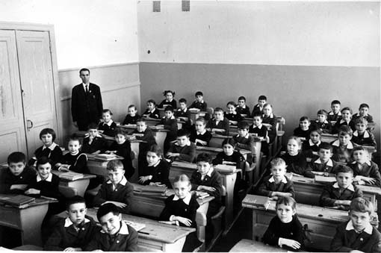
Imagine?
Care?
Act?

Slide 9
Empathy and Design

Slide 10
Monday, November 11 Project Day
Task: re-design LASS classroom to make a new Science lab
http://www.isp.cz/cf_news/view.cfm?newsid=74
Need empathy: imagine, care, act
Complete this survey in Science class:
https://docs.google.com/a/isp.cz/forms/d/1PZCNBUwpnLsmBIkbGV0YCfkT4LB3DP232gerZrp5OWc/viewform

Slide 11
Guest Speaker
Wednesday Advisory time in Theater
Mr. Peter Wojtusiak, Architect from Chapman Taylor, Prague
Collecting questions
Write 1 or 2 questions on this document
Link on the Science webpage
https://docs.google.com/a/isp.cz/document/d/1FBc1xW6WhgkdVRbluZ69vuwKHqaUUx-GazxizRn5Guw/edit

Slide 12
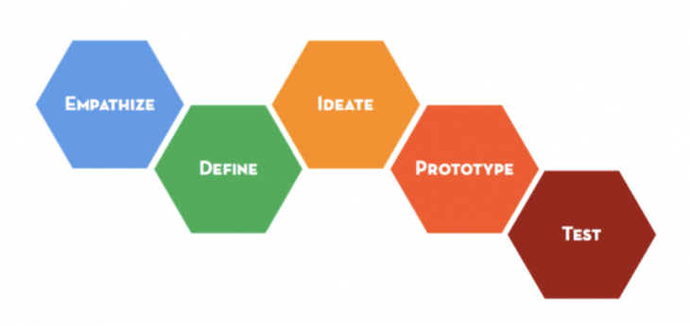
Nov. 11 Project Day
Designing the
Middle School
Science Classroom

Slide 13
Today’s Schedule
Session 1: 8:10-9:20 Theater
Break 9:20-9:35
Session 2: 9:35-11:35 Advisory Classes
Lunch 11:35-12:20
Session 3: 12:20-13:35 Advisory Classes
Break 13:35-13:45
Session 4: 13:45-14:15 Blue Room
Session 5: 14:15-15:00 Gym

Slide 14
Expert Advice and Inspiration
Mr. Sapir
Architect
Din and Ben’s Dad

Slide 15
Design Process

Slide 16
Design a Science Classroom

Slide 17
A person with empathy is
able to imagine how someone else is feeling
able to care about how someone else is feeling
able to act in helpful way

Slide 18
Practice: Design a New Wallet for Mr. Monks

Slide 19
Design Brief: New Wallet
What are the
most important things this new wallet must have?

Slide 20
Design a new wallet
Remember the most important things (Design Brief)
5 minutes…be quick!
Work on scrap paper
Draw and annotate (labels + descriptions)
Pair and share

Slide 21
Design a Science Classroom

Slide 22
Design Brief: New Science Classroom
What are the
most important things this new Science classroom must have?

Slide 23
A person with empathy is
able to imagine how someone else is feeling
able to care about how someone else is feeling
able to act in helpful way

Slide 24
Data from Survey of MS Students
Google doc survey
All Middle School students
Designers must have empathy for the people they are designing for

Slide 25
Percent of people who are happy with:

Slide 26
Favorite Learning Styles:
working in small groups
going outside
going on field trips
using laptops
doing hands-on experiments
designing and creating objects
making videos

Slide 27
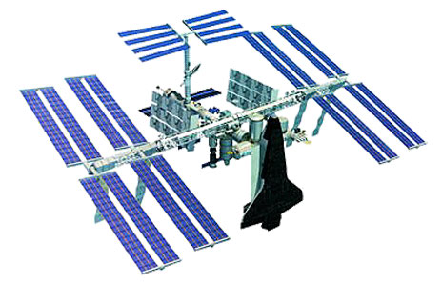
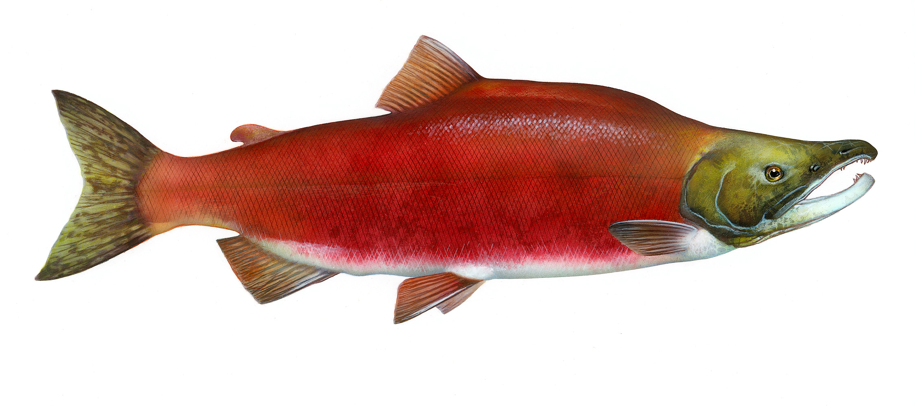
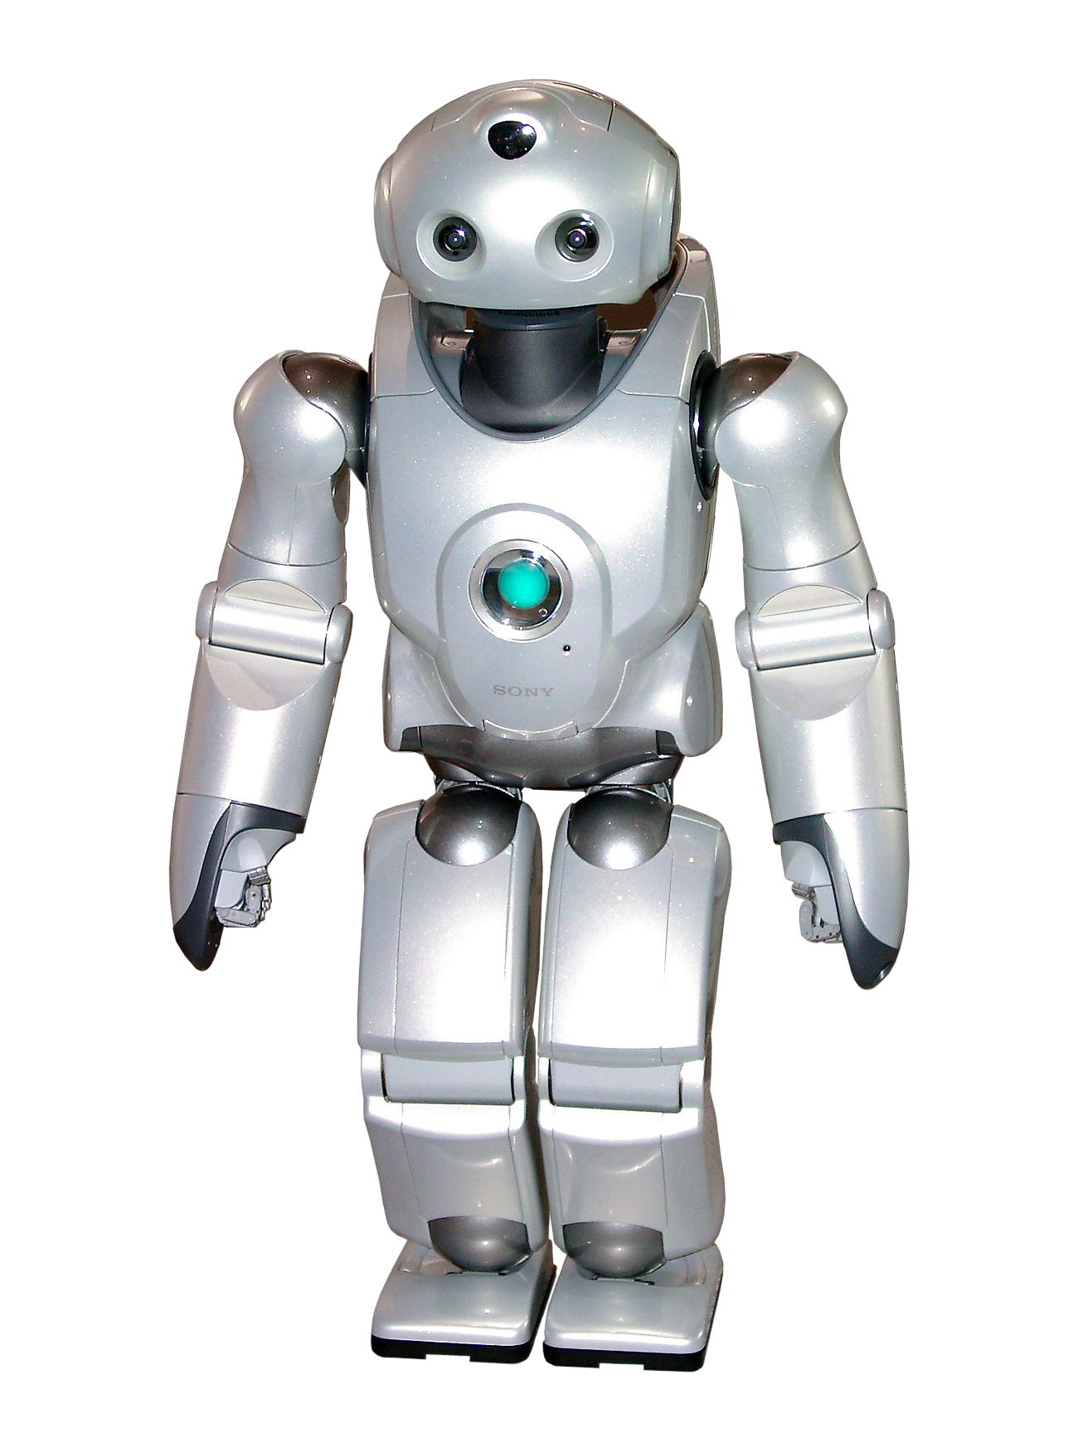
Topics Students Want to Study:
Dissections
DNA
Animals
Space
Robots
Explosions

Slide 28
Data from Survey of MS Students Random Ideas:
Desks and walls with touchscreens
Small sitting area with comfy sofa
Slow motion cameras
Place to experiment with food
An outside classroom workspace
Class animal space
Garden
Aquarium with a shark
Wind tunnel
Flight simulator
Tools to make cheese

Slide 29
Design Brief: New Science Classroom
What are the most important things the new Science room must have (according to the students)?
More space
More comfortable chairs
Different colours
Better wall displays
Make equipment easier to find
Room for work in small groups

Slide 30
Design Brief: New Science Classroom
What are the most important things this new Science classroom must have (according to the teachers)?
gas, electricity, sinks
door at one corner.
rectangular space + 4 walls
room for 24 students

Slide 31
Design a Science Classroom

